Slide 1

Hospital Management System
Name : Sidakdeep Singh Bhatia
Roll No: 2110993838
Name: Tanuj Sharma
Roll No: 2110993846

Slide 2



Topics
Introduction
Aim of Project
Flowchart
Problem And Solutions
Project Working
Result
Advantages
Summary

Slide 3




Introduction
Hospital Management System is designed for multispecialty hospitals, to cover a wide range of hospital administration and management processes.
It is an integrated end-to-end Hospital Management System that provides relevant information across the hospital to support effective decision making for patient care, hospital administration in a seamless flow.
It is a software product suite designed to improve the quality and management in the areas of clinical process analysis and activity-based costing. Managing the key processes efficiently which are critical for the success of the hospital management.

Slide 4



Aim Of project
Providing online Medical care System To user.
Providing an online booking system to user and avoiding human efforts.
Providing a website to user to access it and know about all the facilities provided by hospitals
Helping patient even in case of emergencies.

Slide 5
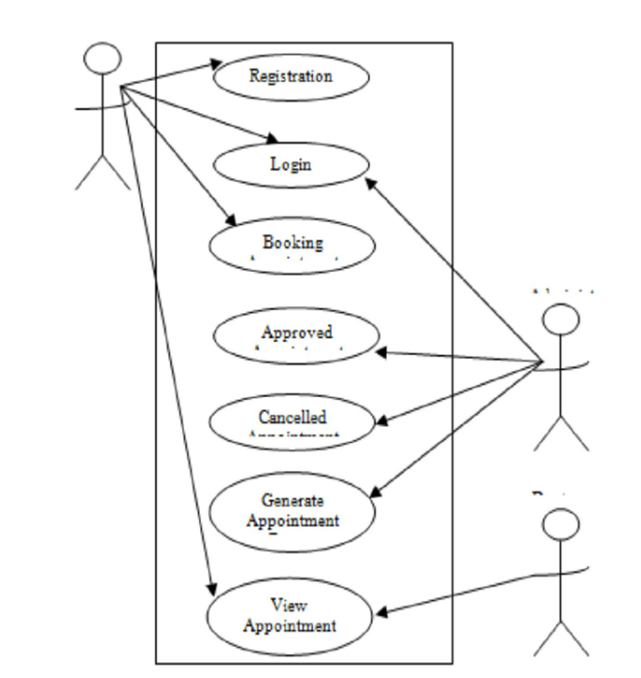
Flowchart
Hospital Mangement And Doctors
Patient
Accessing all Facilities of the hospital and getting a proper care
Providing services to patient and looking after their care .

Slide 6
Problem And Solutions
Problems
Solutions
The information is very difficult to retrieve and to find particular information like- E.g. - To find out about the patient’s history, the user has to go through various registers. This results in inconvenience and wastage of time.
Various changes to information like patient details or immunization details of child are difficulty make as paper work is involved
Manual calculations are error prone and take a lot of time this may result in incorrect information. For e.g. calculation of patient’s bill based on various treatments.
Providing efficiency in user service.
Appointment Booking and canceling service.
Data Storage services .
Emergency Email Services
Information Of Doctors and other staff members.
User Login id service system.

Slide 7
Project Working
Login Page
User Firstly Need To Enter a valid Username and Password to Login.
Home Page
On getting login the Home page
Of the website will be opened from where user can access all the
Commands of our site.
Blogs
Home page will be containing all the commands user can access them and open different command and blog pages.
Bookings
Emergency
In case of any Emergency The user just need to fill form and click on send button his response would be stored, and an email would be sent to doctor.
On Clicking on Booking the user can get a form to fill and book appointments these data of appointments will remain save so user can change or cancel them

Slide 8


Result
About Us
Home Page

Slide 9
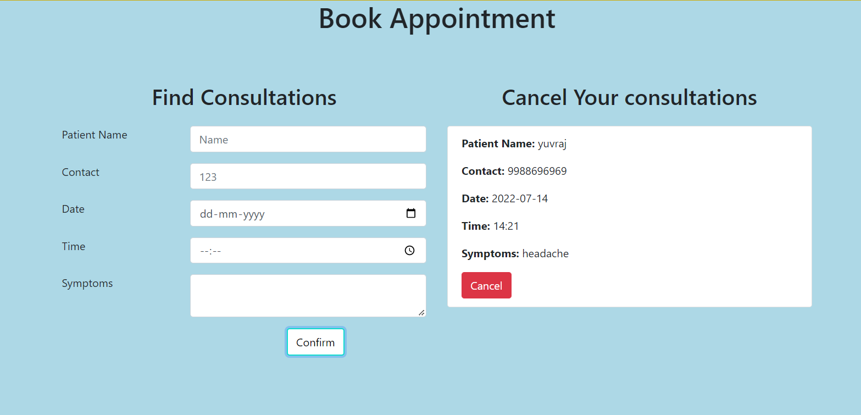
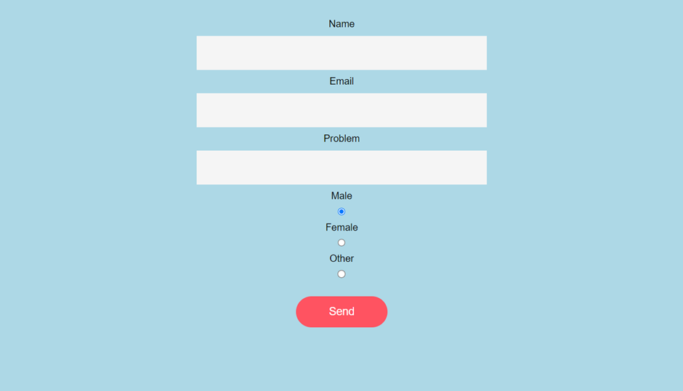
Result
Email Sender
Booking System

Slide 10
Advantages Of Online Care System
Prior appointments are very important as these ensure that you are going to save your time. And if it is a matter of meeting some doctor, it becomes more crucial and reflects that you value your time as well as the time of the doctor you are visiting. And this can become possible through our project.
Such facilities help to create a less exhausting system. It reduces the workload of the hospital staff and also the long queue of patients waiting for the appointment. Hospital staff can save some time and can focus on other critical issues to provide you with the best healthcare facilities.
The hospital staff can keep a track record of their patients more efficiently for the best treatment.
Even Hospital that will use this system would be setting a benchmark for other hospital to get online support system for user.

Slide 11

Summary
The purpose of the project entitled as “HOSPITAL MANAGEMENT SYSTEM "is to computerize the Front Office Management of Hospital to develop software which is user friendly simple, fast, and cost-effective.
It deals with the collection of patient’s information, diagnosis details, etc. Traditionally, it was done manually. The main purpose of the system is register and store patient details and doctor details and retrieve these details as and when required, and also to manipulate these details meaningfully System input contains patient details, diagnosis details, while system output is to get these details on to the screen.
The Hospital Management System can be entered using a username and password. It is accessible either by an administrator or receptionist. Only they can add data into the database. The data can be retrieved easily. The data are well protected for personal use and makes the data processing very fast.

Slide 12


Thank You
Sidakdeep Singh Bhatia
211099383
Tanuj Sharama
2110993846

